Slide 1
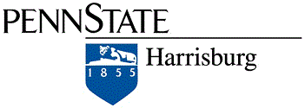
DISTRIBUTED WHITEBOARD
Distributed Whiteboard
Krishna Gadia
Mrinalini Vasanthi
COMP 512

Slide 2
WHAT?
Distributed whiteboard is a two-way communication platform
Used for drawing/writing
Multi-client with a centralized server

Slide 3
WHY?
Can be used effectively in real-time for various purposes
Convenient
Easy to access resources

Slide 4
WHERE?
Teaching environment
Office setup – meetings
Brainstorming sessions
Team projects

Slide 5
OTHER WHITEBOARDS
Kerika
https://kerika.com/en/whiteboards.html
Price : $7/month
Features : Draw flowcharts and share content on a canvas

Slide 6
Web Whiteboard
http://webwhiteboard.com/#/
Features : Online tool for drawing and writing content with other users.
Does not implement a chat tool with it.

Slide 7
FEATURES
Graphical shapes
Color palette
Eraser
Free-hand
Chat application
Interrupt Notification

Slide 8
Modules
Distributed Whiteboard
Chat Application

Slide 9
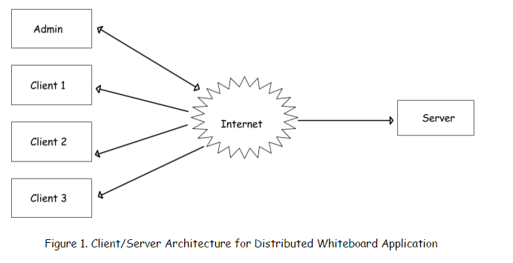
ARCHITECTURE

Slide 10
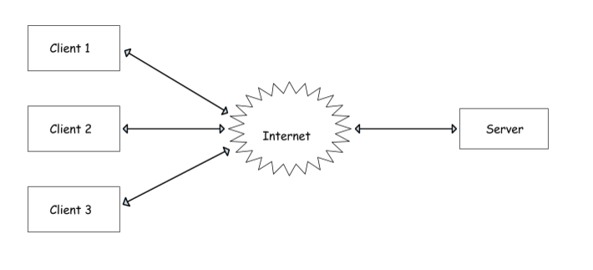
CHAT APPLICATION

Slide 11
TECHNOLOGIES USED
Java
Platform independent, multi-threaded application
Abstract Window Toolkit (AWT)
AWT is used to make the JFrame ,JPanel and other components
Swing
GUI of the application

Slide 12
Socket programming
Enable communication between clients and server and also for multi-client chat application

Slide 13
IMPLEMENTATION DETAILS
Token
Mode
Multi-threaded application
Socket programming
TCP

Slide 14
DESIGN DECISION
TCP vs UDP
Client/Server vs Peer-Peer
Synchronization

Slide 15
CHALLENGES
Free-hand tool
Network latency
Token implementation on the server side
Multiple Sessions

Slide 16
CONCLUSIONS & FUTURE WORK
Provide a voice over IP feature that enables clients to listen to the admin
Can add security to the chat
Provide a recovery mechanism(backup server in case of server crash) in case of failure
Extend the chat to enable video conferencing

Slide 17
DEMO
https://github.com/KrishnaGadia/Distributed-Whiteboard

Slide 18
QUESTIONS?

